Slide 1
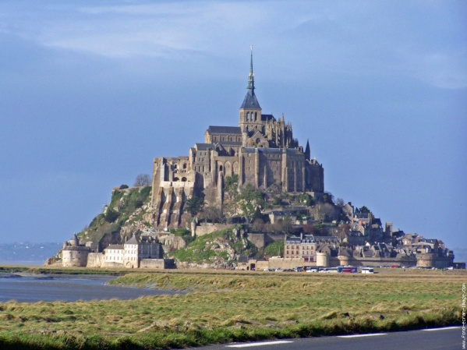
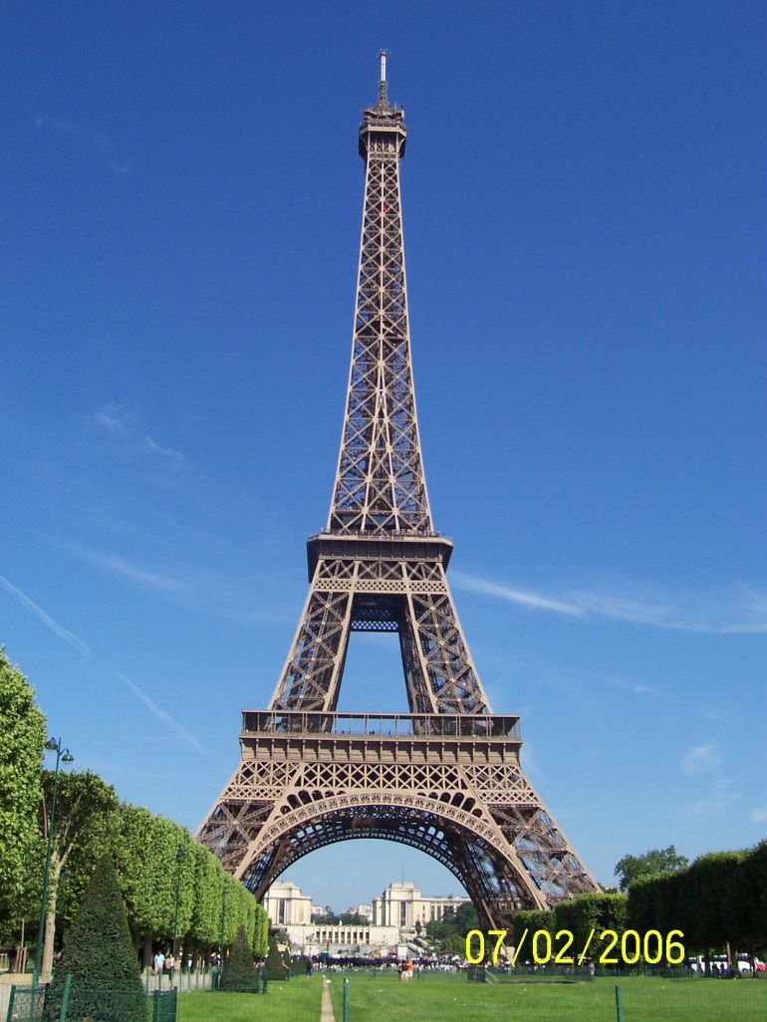
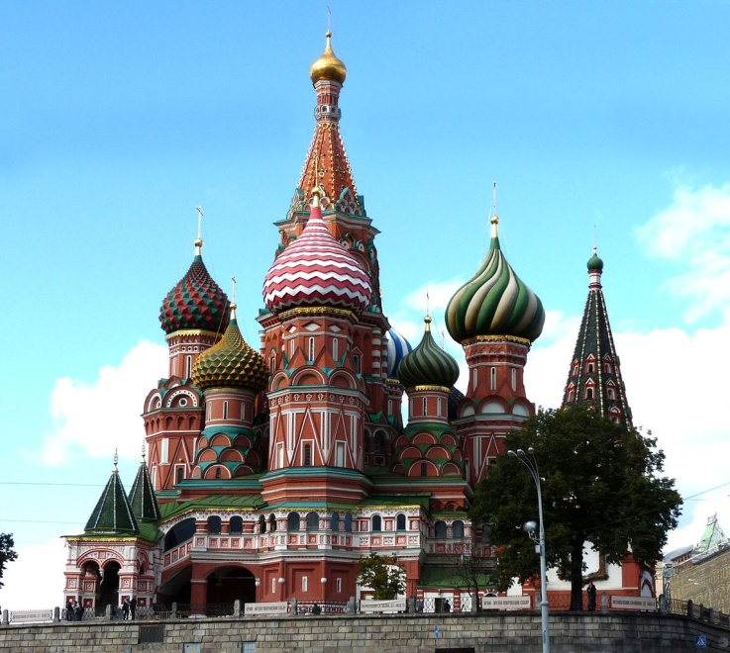
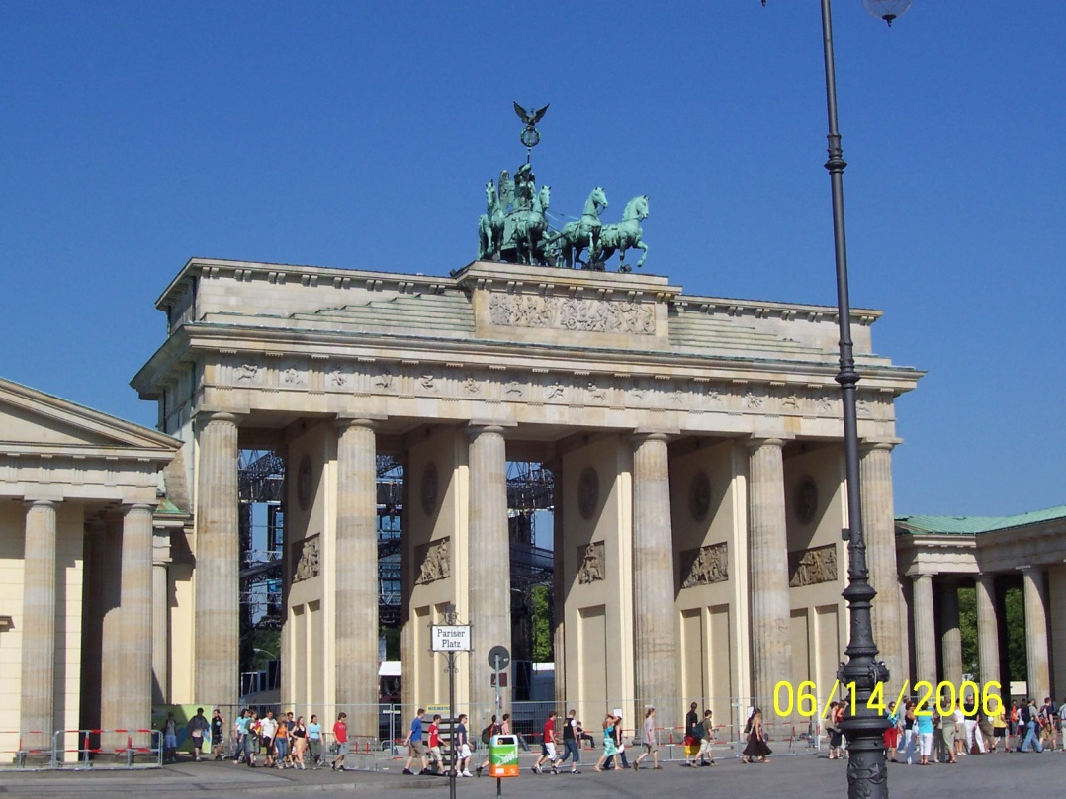
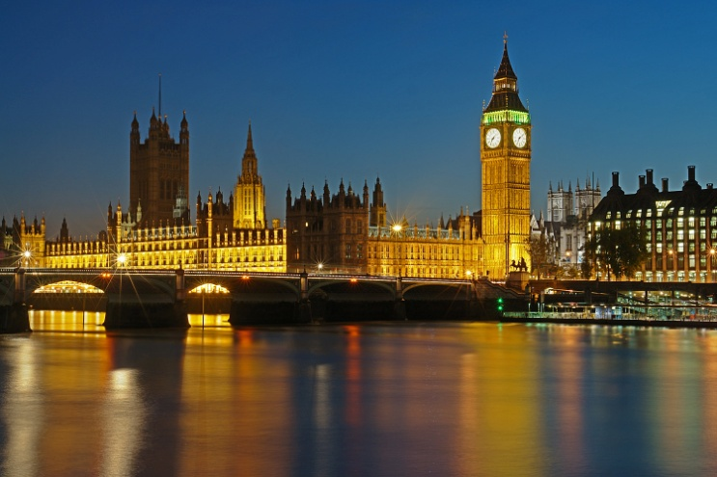
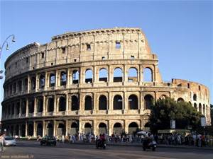
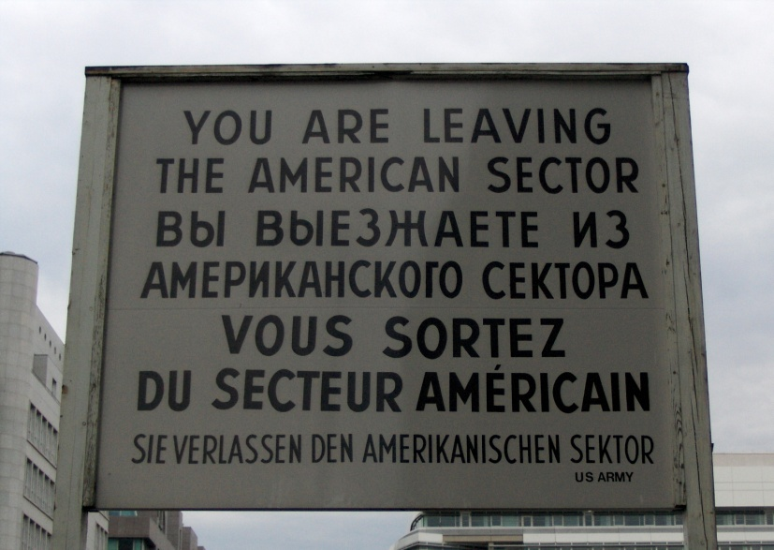
EUROPE

Slide 2
Europe: An Asian Peninsula?

Slide 3
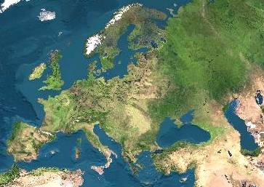
Satellite View of Europe

Slide 4
Introduction
Europe and Russia occupy part of the huge landmass called Eurasia. Eurasia is divided into two continents, Europe and Asia. The difference between them is cultural and historical, not geographical.
Europe is the world's second smallest continent. Oceans and seas border Europe to the north, south, and west. Asia borders Europe on the east. The Ural Mountains and the Caucasus Mountains mark the dividing lines between Europe and Asia.
Russia is the world's largest country. It spreads over two continents, Europe and Asia.

Slide 5
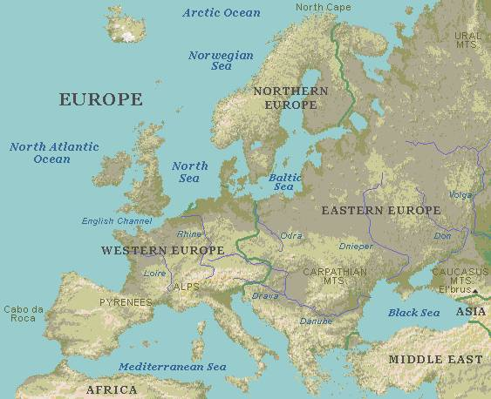
R
E
G
I
O
N
S

Slide 6
Seas and peninsulas
Europe is surrounded by many seas: the Baltic Sea, the North Sea and the Mediterranean Sea.
Between Europe and Asia: Black Sea and the Caspian Sea (which is actually the largest lake in the world).
In Europe there are many peninsulas: the Scandinavian Peninsula and the Jutland Peninsula in the north, the Balkan Peninsula, the Iberian Peninsula and the Italian Peninsula in the south.
Several big islands are also part of Europe; the biggest are Great Britain, Ireland and Iceland.

Slide 7
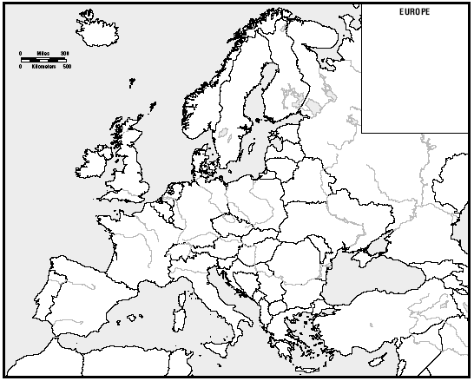
B
o
d
i
e
s
of
W
a
t
e
r
Arctic
Ocean
Atlantic
Ocean
North
Sea
Baltic
Sea
English Channel
Caspian
Sea
Black
Sea
Dardanelles
Strait
Adriatic Sea
Strait of
Gibraltar
Tyrrhenian
Sea
Aegean
Sea
Mediterranean Sea

Slide 8
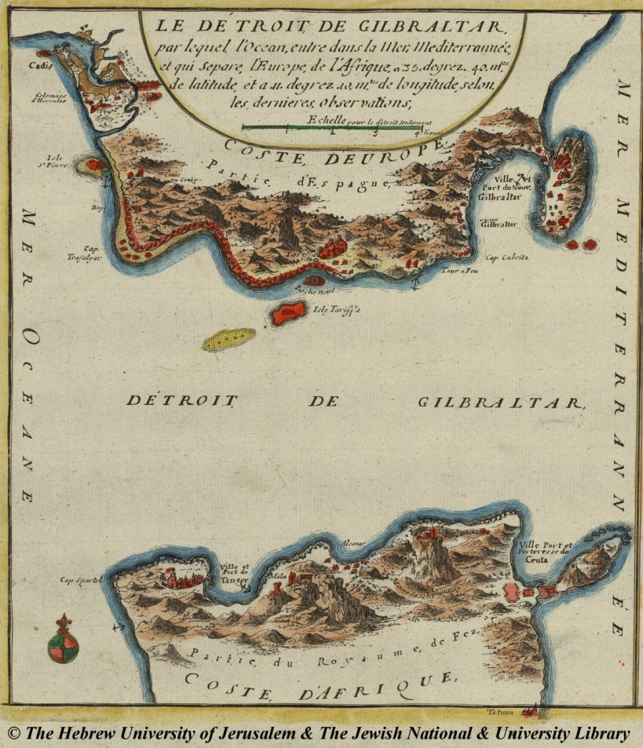
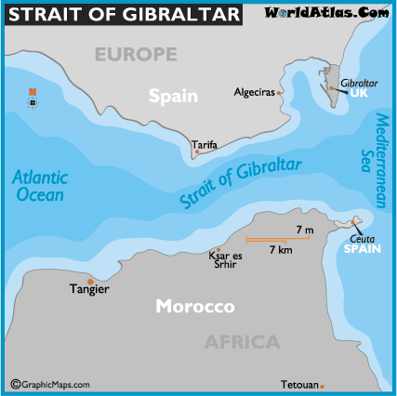
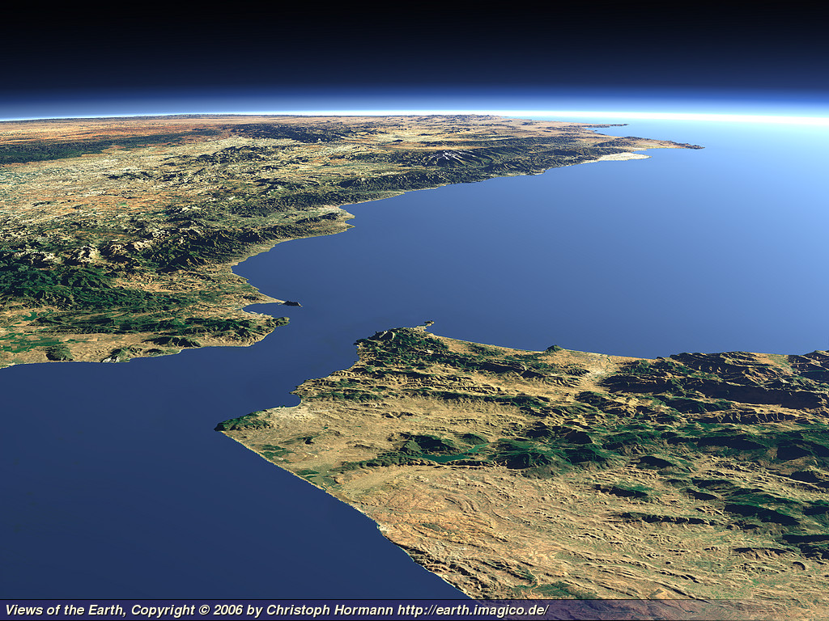
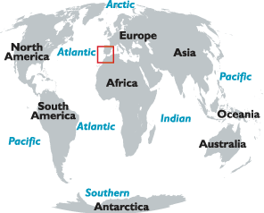
The Strait of Gibraltar separates the Iberian Peninsula from Africa and connects the Atlantic Ocean and the Mediterranean Sea.

Slide 9
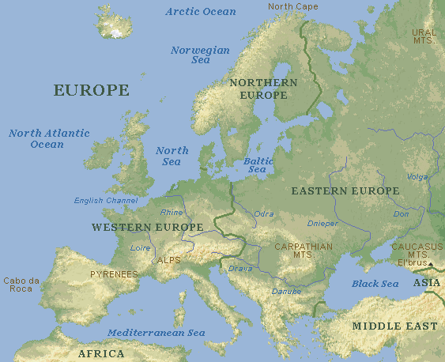
Northern peninsulas
Scandinavian Peninsula
Jutland Peninsula

Slide 10
Southern peninsulas
Iberian Peninsula
Italian Peninsula
Balkan Peninsula

Slide 11
Mountains
Mountains in northern Europe: Scandinavian Mountains, Ural Mountains, Massif Central, Grampians, Pennines, Cambrians. More ancient → not so high.
Mountains in southern Europe: Pyrenees, Alps, Apennines, Dinaric Alps, Carpathians, Balkan Mountains, Caucasus Mountains. Younger (they were formed during the Alpine Orogeny) → high and sharp.

Slide 12
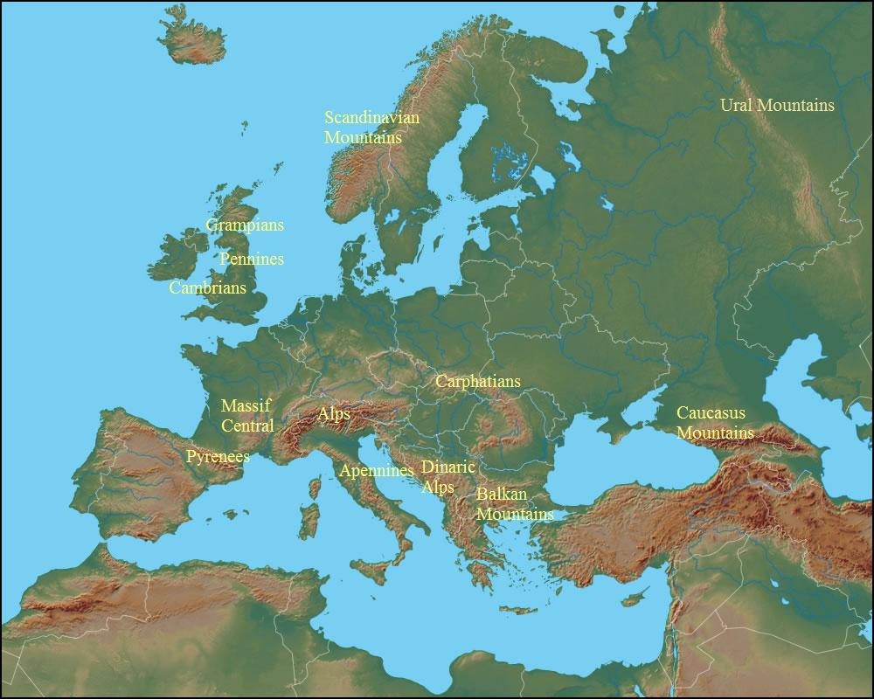

Slide 13
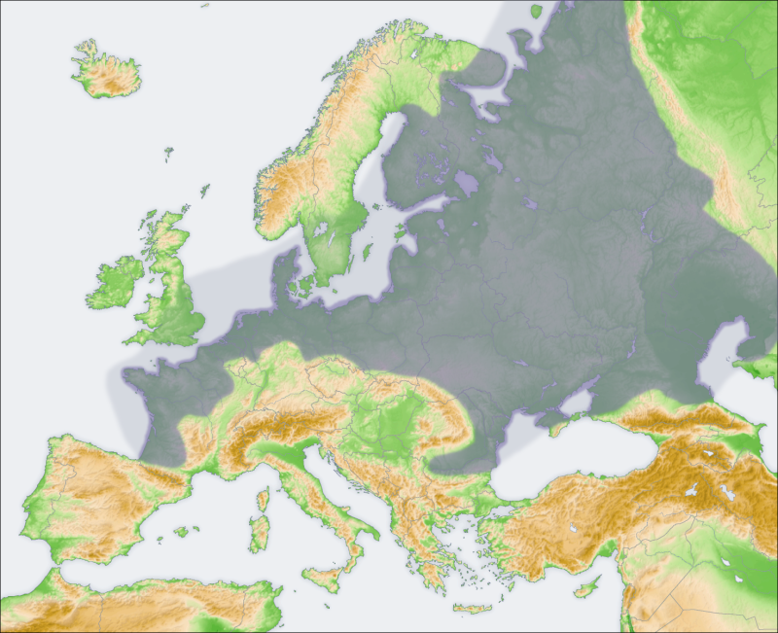
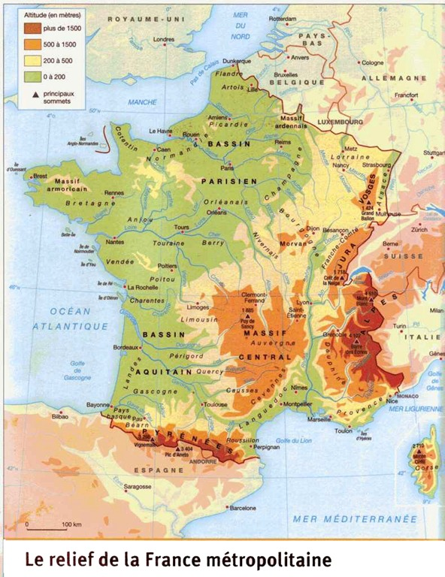
Plains in northern Europe
European Plain
(Aquitaine and Paris Basins + German Lowland + Sarmatic Plain)
London Basin
Sarmatic
Plain
German Lowland
Paris Basin
Aquitaine
Basin
The German Lowland and the Sarmatic Plain are erosional plains, the Basins are alluvial plains.

Slide 14
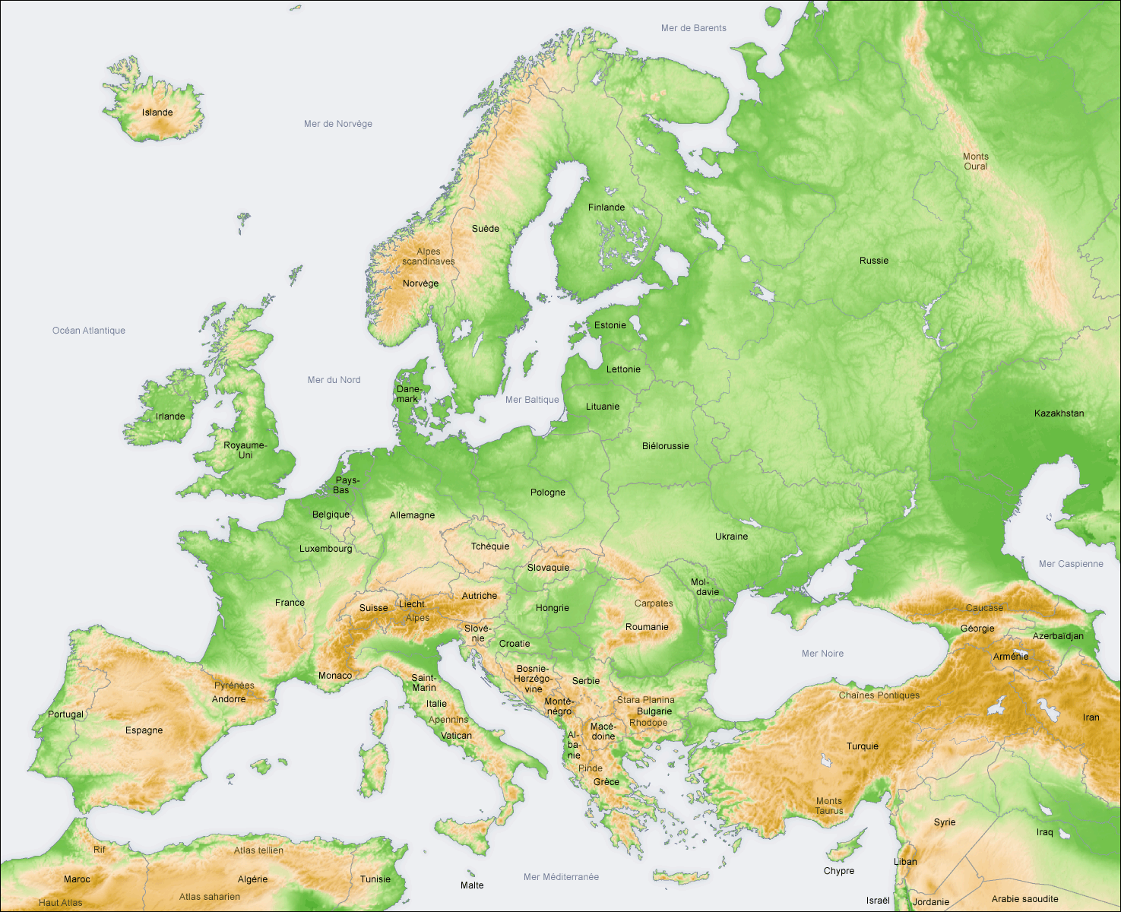
Plains in southern Europe
1= Padan Plain
2 = Hungarian Plain
3 = Wallachian Plain
They are
alluvial plains
1
2
3

Slide 15
Rivers and lakes
Large rivers:
water highways
sources of drinking water
power for electricity.
The longest river is the Volga, the second one is the Danube.
The most important river for economic purposes is the Rhine. On its estuary lies Rotterdam, the largest port in Europe.
The largest lakes in Europe are the Ladoga and the Onega, both in Russia. There are many lakes in Finland, Scotland and in the Alps. They are mostly glacial lakes. In Hungary lies Lake Balaton.

Slide 16
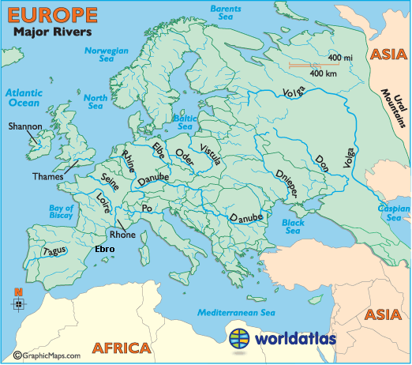

Slide 17
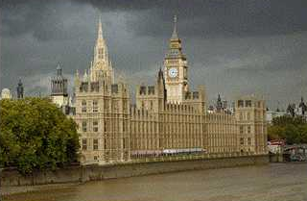
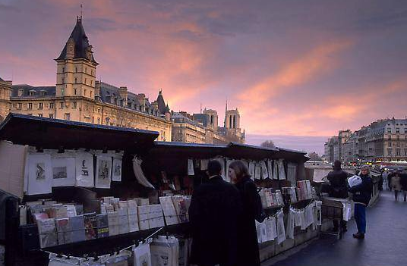
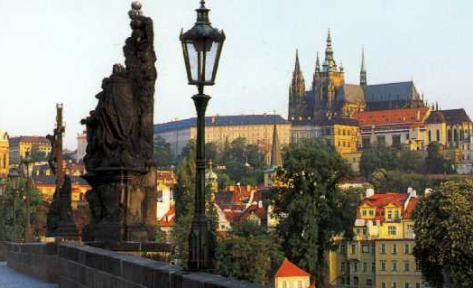
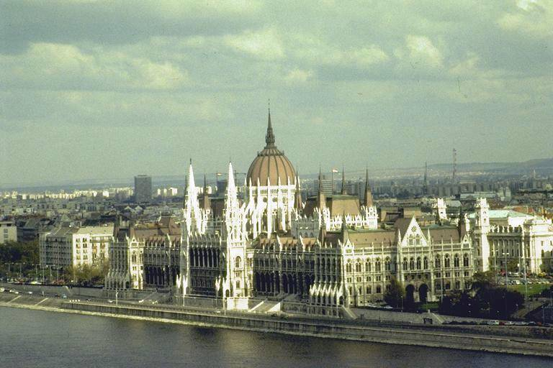
Capitals on the Rivers (1)
London on the Thames
Paris, right bank of the Seine
Prague on the Vltava
Budapest on the Danube

Slide 18
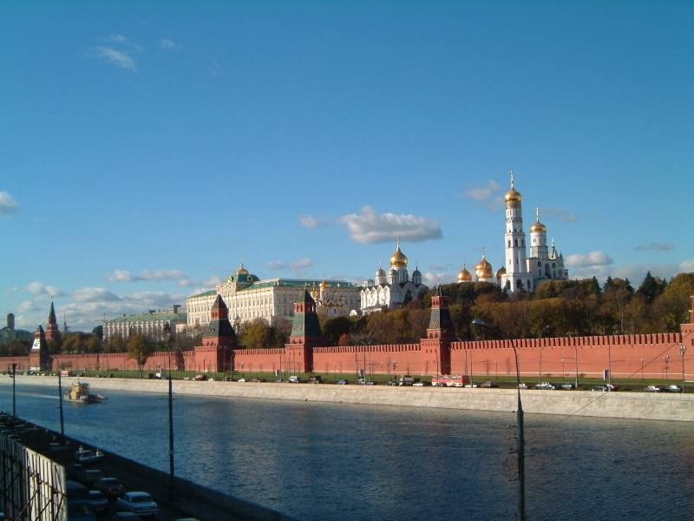
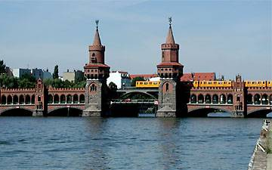
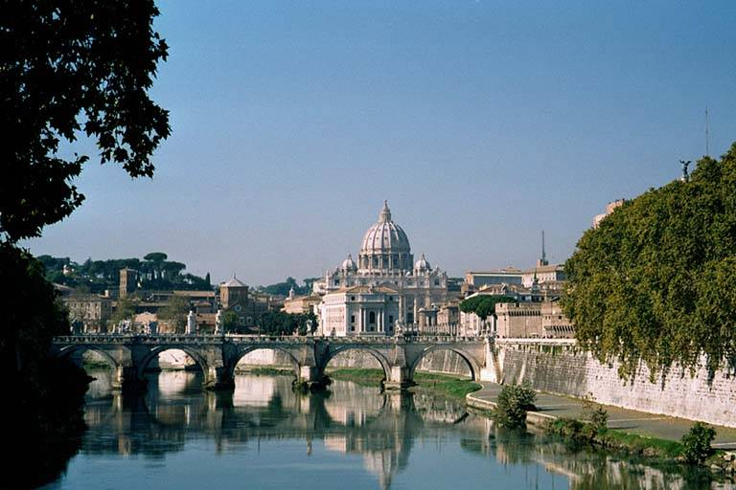
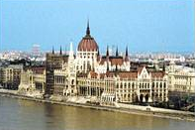
Capitals on the Rivers (2)
Moscow on the Moscow River
Berlin on the Spree
Rome on the Tiber
Vienna on the Danube

Slide 19
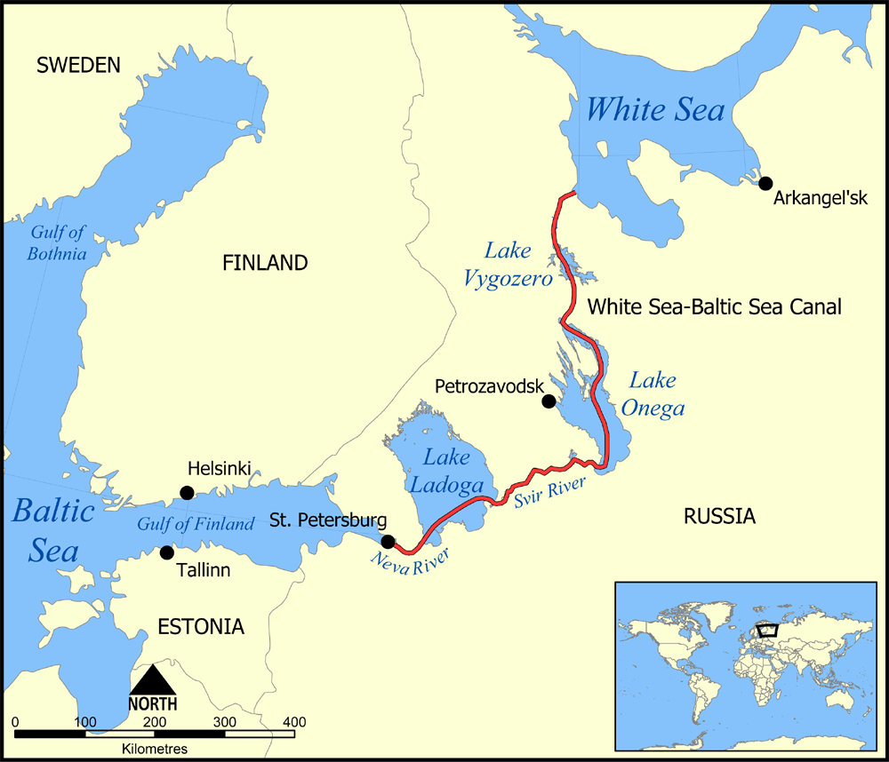
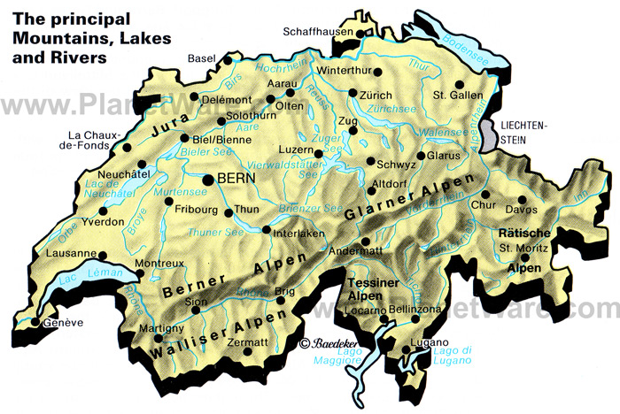
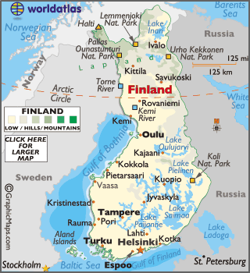
Lakes in
Switzerland
The White Sea – Baltic Sea Canal
Lakes in Finland

Slide 20
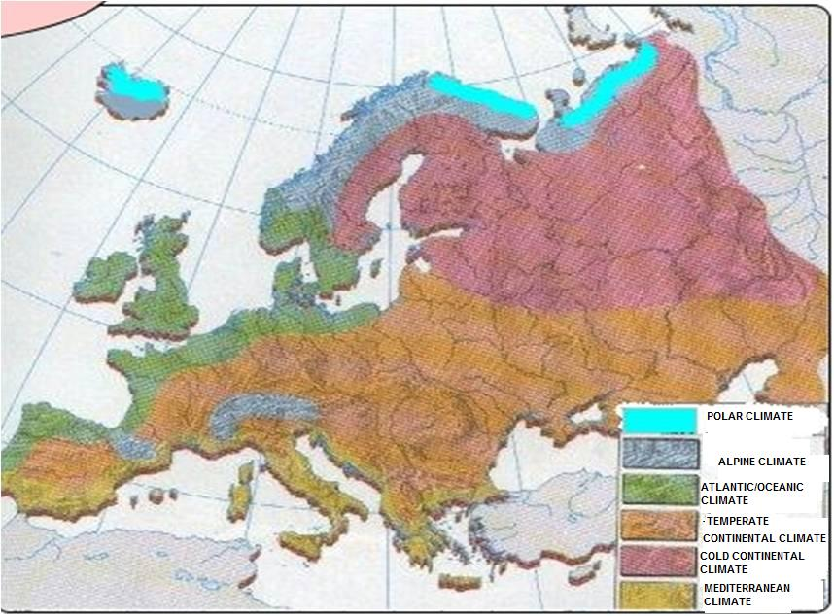
Climate in Europe

Slide 21
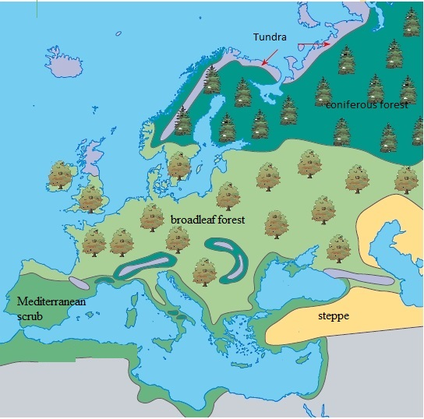
Vegetation in Europe

